Slide 1
human activity recognition in video Benchmark ： a survey
tej singh and Dinesh kumar vishwakarma

Slide 2
introduction
vision based human activity recognition is becominga trendy area of research due to it is borad application . such as security and surveillance , human computer interactions, patients monitoring system and robitics. for the recognition of human activity various approachs have been developed and to test the performance on these video datasets. hence , the objective of the survey paper is to outline the different video datasets and highlights their merits and demerits under practical considerations.

Slide 3
we have ategorized these datasets into two part:
1.two dimensional (2D-RGB) datasets
2. three dimensional(3D-RGB)datasets

Slide 4
the most prominent(突出， 杰出) challenges involved in these datasets are occlusions , illumination variation, view variation, annotation, and fusion of modalities
the key specification for these datasets are resolutions, frame rate, actions/actors,background, and application domain.

Slide 5
RGB VIDEO DATASET 2D
dataset | year | modality | application doamin
KTH | 2004 | GREY | human action recognition in real outdoor conditions
Weizmann | 2005 | RGB | Human action recognition
IXMAS | 2006 | RGB | multi-view-invariant action recognition
CASIA action | 2007 | RGB | Human behaviour and human -human interaction
UCF sports | 2008 | RGB | sports actions recognition
Olympic Games | 2008 | RGB | sports actinos recognition
Hlooywood | 2008 | RGB | realistic actions recognition from movies
UT-interaction | 2009 | RGB | human-human interaction activity recognition
BEHAVE | 2009 | RGB | Human group behaviour activity analysis
HMDB51 | 2011 | RGB | human-human human-objectinteraction
UCF50 | 2011 | RGB | human sports activity recognition
BIT-Interaction | 2012 | RGB | human-human interaction in realistic scenarios
UCF101 | 2013 | RGB | Human sports activity recognition
YouTube sports 1M | 2013 | RGB | human sports activity recognition
ActivityNet | 2015 | RGB | human activity understanding
THUMOS’15 | 2015 | RGB | action recognition in wild video
ChaLearn: action/interaction | 2015 | RGB | automatic learning of human action and interaction
FCVID | 2015 | RGB | human activity understanding
youtube 8M | 2016 | RGB | human activity recognition, human interaction
Okutama action | 2017 | RGB | concurrent human action recognition form aerial view

Slide 6
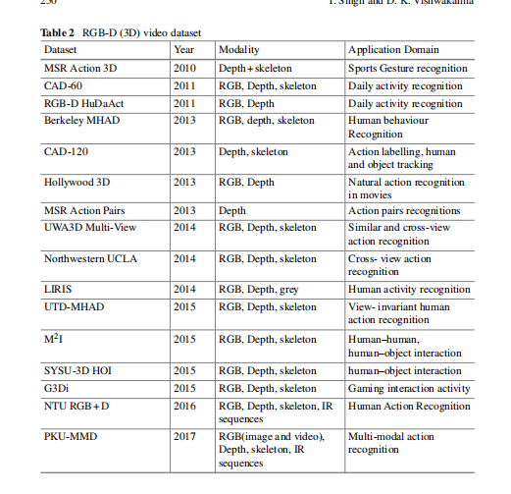
RGB 3D video dataset

